Slide 1
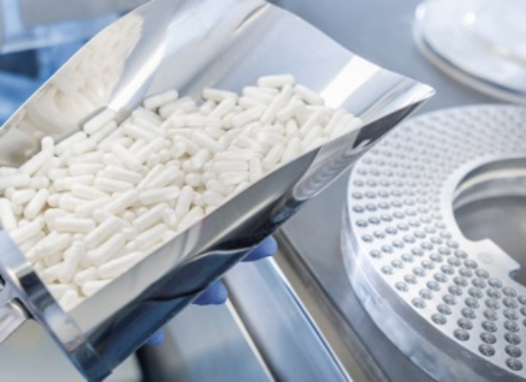
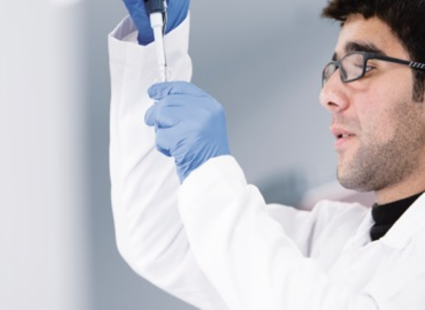
Management Report to the Board of Directors
March, 26th 2019
PROMOPHARM SA

Slide 2
Management Report to the Board of Directors
Business Highlight for 2018
Business performance
Analysis of financial statements
2019 Full year Expectations

Slide 3
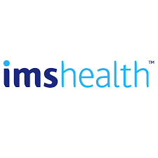
Business Highlight for FY 2018
- Sales’ evolution in 2018 :
  Private Market :
In 2018, sales of medicines in Morocco, according to IMS Health, recorded a turnover of 9.5 Bn MAD, an evolution of 5.3% compared to the year 2017. Promopharm recorded an increase of 6.7% in term of turnover.

Slide 4
Business Highlight for 2018
Sales’ evolution in 2018 :
  Private Market :
  Public Sales :
  The tender sales have been negatively impacted during 2018 due to :
        reducing the volumes of tender launched at the end of 2017 on one hand;
        delaying the notifications of 2018 tenders’ launched in low volume also.
The market share of Promopharm achieves 3,9% of the total local market of medicines (Private market).

Slide 5
Business Highlight for 2018
New MA :
Promopharm's portfolio has expanded in 2018 by obtaining new Marketing Authorizations, which include :
Brand Name | Indication
DUSTA | Benign Prostatic Hypertrophic
CISPLATINE THYMOORGAN | Cancer
XERACTAN | Severe Acne
CLORMETIN / CIPREL / SILON | Hormonal Contraception
ENDOGEST | Endometriosis
CARBOPLATINE THYMOORGAN | Cancer of the skin
PERGOVERIS MERCK | Low levels of adult women’s hormones

Slide 6
Business Highlight for the FY 2018
New launches :
The year 2018 has been marked by the launch of new strategic products contributing to the improvement of the Moroccan citizen’s health. These include, among others, the products below :
DRUG | INDICATIONS
EXIDEP | It’s an antidepressant which is used to treat the symptoms of depression and other pain disorders.
ISOX | Celecoxib is a nonsteroidal anti-inflammatory drug used to treat pain or inflammation.
XERACTAN | Isotretinoin (the API of the generics of Roaccutane®) is an effective treatment of severe acne.

Slide 7


Business Highlight FY 2018
Termination of the contract with ALES GROUP:
During a collaboration that lasts for more than 24 years ago, Promopharm succeeded to develop the brands Pyhto & Lierac on the Moroccan Territorry (Annual turnover of 30 Mn MAD).
ALES GROUP decided to make a direct investment via creation of its own subsidiary starting from this year.
Signature of new distribution contract with HORMETA
HORMETA is a premium Dermo cosmetic brand from Switzerland.
We expect that HORMETA sales will compensate the major part of ALES GROUP sales in the medium term.

Slide 8


Business Highlight FY 2018
Changing of the visual identity starting from 27/03/2018 :
Promopharm changed its visual identity & adopted the new brand of Hikma Group :
To strengthen the corporate identity, corporate image and corporate reputation;
To unify the look on group level and to feel immediately identifiable and recognizable in the marketplace.

Slide 9

Business Highlight FY 2018
VALSARTAN
In July 2018, and on a preventive manner, the Department of Medicines and Pharmacy of the Ministry of Health ordered the removal of all lots of certain valsartan-based medicines provided by the manufacturer Zhejing Huahai Pharmaceutical Co-China.

Slide 10
Business Highlight for FY 2018
Changing of the GM & appointment of new pharmacist Responsible
On 17 December, Mr Brahim Oulammou General Manager - Pharmacist Responsible left Promopharm.
The board appoints :
- Mr Abdelkrim KABECHE as General Manager,
- Mr Mohamed Amine BELGHITI ALAOUI as Pharmacist Responsible.

Slide 11
Management Report to the Board of Directors
Business Highlight for FY 2018
Business performance
Analysis of financial statements
2019 Full year Expectations

Slide 12
Business performance
Decline of business performance FY 2018 :
The net profit of PROMOPHARM SA for the first half of 2018 decreased by MnMAD 27 compared to the year 2017.
This decline was largely caused by a decrease in sales, primarily due to three reasons as has been displayed in the profit warning published on January 25th 2019.
  Increased competition, in addition to price erosion for some medicines,
  Reduction in tender sales,
  The termination of a distribution agreement with ALES GROUP, and
  The industry-wide recall of Valsartan imposed by the Ministry of Health.

Slide 13
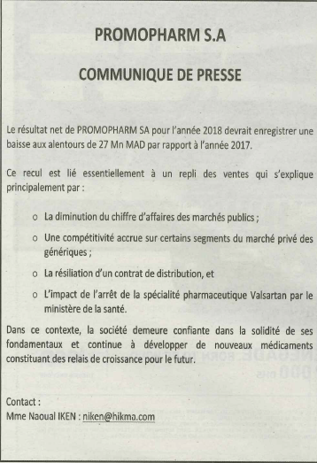

Business performance
The business performance decline lead Prompharm to issue a profit warning in compliance of the Casablanca Stock Exchange Regulations.

Slide 14
Business performance
Decline of business performance FY 2018 :
  Increased competition, in addition to price erosion for some medicines

Slide 15
Business performance
Decline of business performance in FY 2018 :
  Reduction in tender sales

Slide 16
Business performance
Decline of business performance in FY 2018 :
  The termination of a distribution agreement with ALES GROUP, and

Slide 17
Business performance
Decline of business performance in FY 2018 :
  The industry-wide recall of Valsartan imposed by the Ministry of Health

Slide 18
Business performance
Gross Margin Comparison 2018 vs 2017 :
Despite the decrease of sales, Promopharm kept the same level of the gross margin rate approximatively (Increase of 0,6%).

Slide 19
- IMS Analysis : Companies with licensors
Business Highlight for FY 2018
Companies | RK | Units | Value KMAD | %PPG | %M.S
MAROC |  | 307 699 | 9 453 622 | 5,3 | 100,0
COOPER | 1 | 38 126 | 945 794 | 4,4 | 10,0
SANOFI-AVENTIS | 2 | 25 365 | 873 035 | 3,4 | 9,2
SOTHEMA | 3 | 21 560 | 837 929 | 3,1 | 8,9
LAPROPHAN | 4 | 20 164 | 626 557 | -0,1 | 6,6
BOTTU SA | 5 | 29 849 | 610 918 | 8,3 | 6,5
MAPHAR | 6 | 22 444 | 594 669 | 8,2 | 6,3
GSK | 7 | 11 515 | 495 645 | 1,7 | 5,2
PROMOPHARM-HIKMA | 8 | 16 130 | 373 537 | 6,7 | 3,9
PHARMA 5 | 9 | 15 111 | 330 446 | 3,3 | 3,5

Slide 20
- IMS Analysis : Companies without licensors
Business Highlight for FY 2018
Products | RK | Units | Value KMAD | %PPG | %M.S
Morocco |  | 307 699 | 9 453 622 | 5,3 | 100,0
SANOFI/SANAV | 1 | 24 956 | 840 234 | 3,6 | 9,1
COOPER/COOPER | 2 | 22 399 | 582 257 | 4,3 | 6,3
GLAXOSMITHKLIN/GSK | 3 | 11 481 | 484 730 | 1,3 | 5,3
BOTTU/BOTTU S.A. | 4 | 24 799 | 435 440 | 9,6 | 4,7
PHARMA 5 | 5 | 12 937 | 290 821 | 3,5 | 3,2
LAPROPHAN | 6 | 12 260 | 254 181 | -4,4 | 2,8
SOTHEMA/SOTHEMA | 7 | 4 758 | 253 384 | 5,6 | 2,8
PROMOPHARM | 8 | 12 576 | 250 086 | 10,3 | 2,6
PFIZER/PFIZER S.A | 9 | 7 338 | 243 637 | 2,5 | 2,6
NOVART PH/NOVARTIS | 10 | 3 834 | 225 100 | 14,1 | 2,4

Slide 21
Business performance
Private Market :.
The top 10 products evolution shows positive trend for the 3 first drugs (ESAC, BREXIN & ECOCLAV).
However, UTROGESTAN sales continue declining by 24,4% compared to 2017. This is mainly due to the entry of new competitors in the market impacting its structure and profitability.
Geprid left the competition of top 10 products due to price erosion & to 2016 disruptions’ effects.
Products (+000) | RK | Units | Value LC | %PPG | %M.S
PROMOPHARM-HIKMA |  | 16 130 | 373 537 | 6,7 | 100,0
ESAC | 1 | 657 | 44 011 | 15,1 | 11,8
BREXIN | 2 | 657 | 26 994 | 8,2 | 7,2
ECOCLAV | 3 | 500 | 25 577 | 9,7 | 6,8
AUREOMYCINE | 4 | 6 691 | 24 351 | -0,3 | 6,5
DERMOFIX | 5 | 335 | 17 366 | 5,1 | 4,6
UTROGESTAN | 6 | 296 | 16 441 | -24,4 | 4,4
ZOLAM | 7 | 234 | 12 358 | -0,2 | 3,3
ORAPRED | 8 | 350 | 11 949 | 18,9 | 3,2
FENAC | 9 | 455 | 10 393 | 12,0 | 2,8
BUTOVENT | 10 | 564 | 10 309 | -1,2 | 2,8

Slide 22
Management Report to the Board of Directors
Business Highlight for FY 2018
Business performance
Analysis of financial statements
2019 Full year Expectations

Slide 23
Analysis of financial statements
Assets 2018 vs 2017 :
Decrease of Fixed Assets by 5 Mn MAD, mainly explained by PPE depreciation.
Current Assets was decreased explained by the decrease of the ‘Account Receivables’ despite the inventory increase.
Treasury keeps the same level as per last year..

Slide 24
Analysis of financial statements
Liabilities 2018 vs 2017 :
Increase of Net Equity as a result of non distribution of dividends.
Increase in current liabilities, mainly explained by the level of inventory as mentioned in the slide before.
Treasury Loans aiming to re-financing of major importation vendors decrease by 20% compared to last year.

Slide 25
Analysis of financial statements : P&L 2018 vs 2017
Net Income 2018 Vs 2017:
Significant decrease in EBITDA -34% is mainly explained by :
1- The decrease of Sales by 13%.
2- Increase in Operating expenses by 12%.
3- Increase of Employees Benefits by 3%.

Slide 26
Analysis of financial statements :
Trade payable analysis :
In compliance with the decree Law N° 3030-12 of the 8th November 2012, the table below illustrates the closing’s breakdown, of the trade payable by due date at the end of the last two years :
 | A | B | Trade Paybale
 | Total Trade Payable | Not Yet Due | C | D | E | F
 | A=B+C+D+E+F |  | Due (Less than 30 days) | Due (Between 31 & 60 days) | Due (Between 61 & 90 days) | Due (More Than 90 days)
31/12/2018 | 104 511 518 | 74 348 405 | 6 261 044 | 9 787 583 | 2 354 758 | 11 759 726

Slide 27
Management Report to the Board of Directors
Business Highlight for 2018
Business performance
Analysis of financial statements
2019 Full year Expectations

Slide 28

2019 Full year Expectations
Challenges & Opportunities :
Opportunity
Bio-equivalence for renewal of old products
Price increase approval of Aureomycine
Local manufacturing trend
Noreva new portfolio
New generics for top 10 products
Price increase approval of injectables

Slide 29
Management Report to the Board of Directors
2019 Full year Expectations
We expect :
Increase of the Total Sales of 10%.
Increase of Net Income by 30% to 40%.

Slide 30
Thank you

